Slide 1
Apex Engineering
Value Proposition Canvas

Slide 2
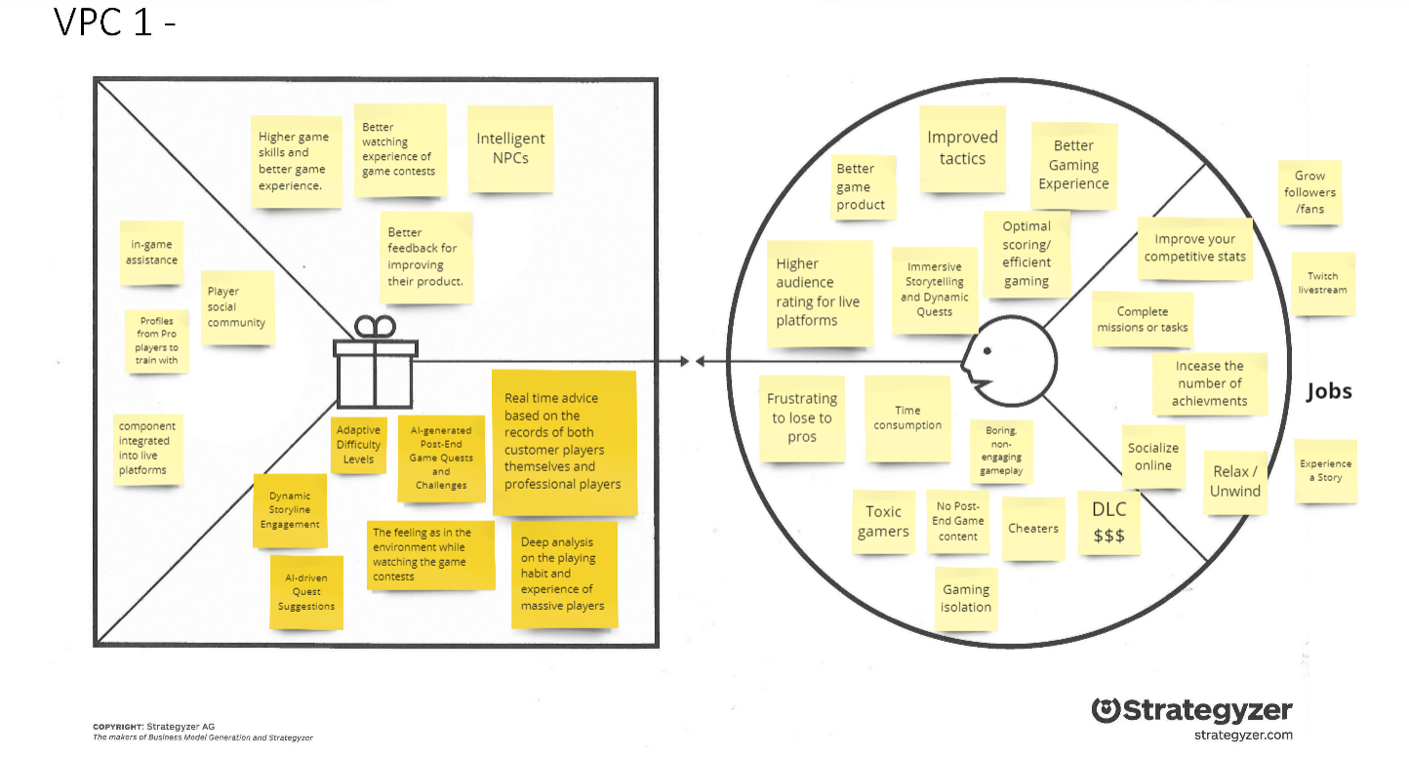
AI Game Companion

Slide 3
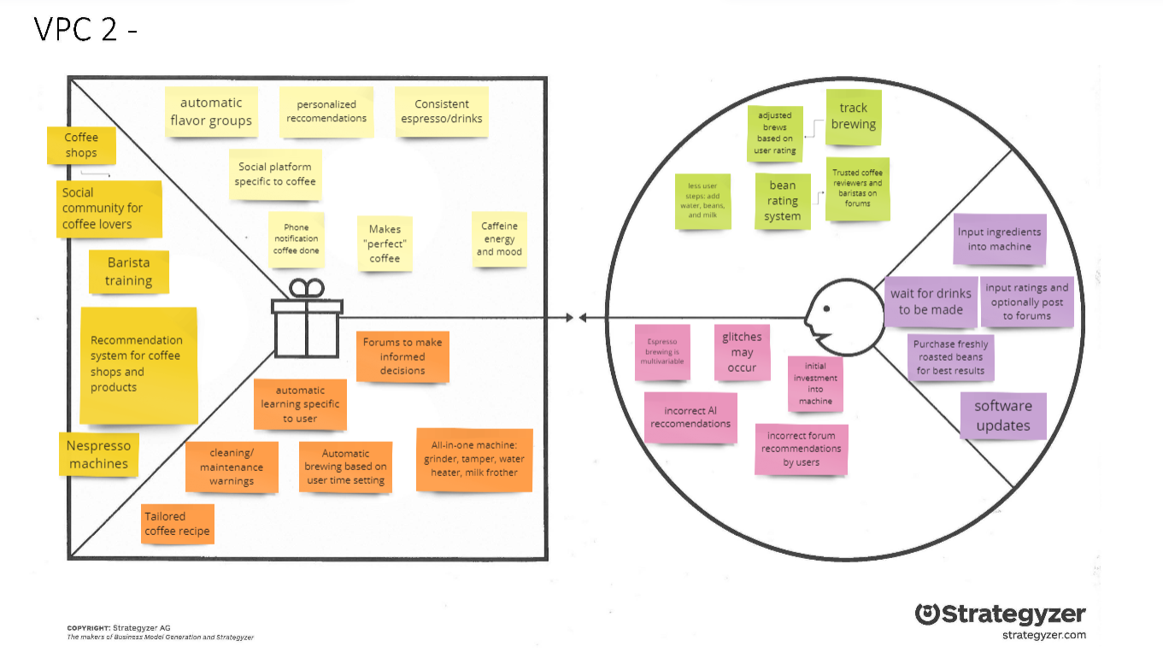
Espresso Machine

Slide 4
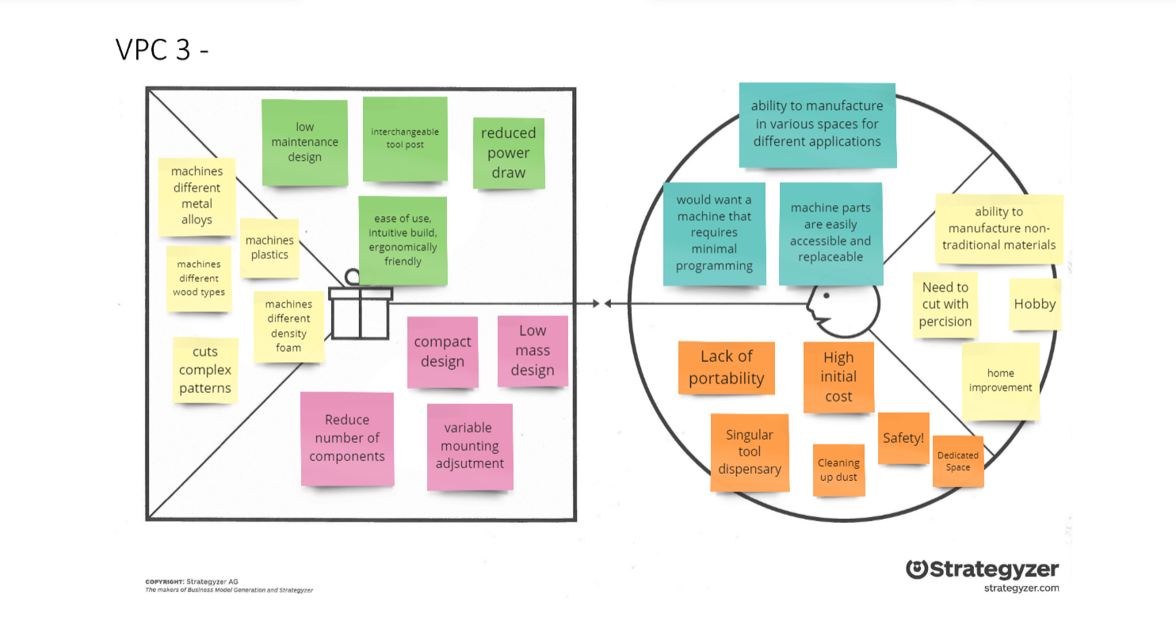
CNC Machine

